Slide 1

Course Id :INT 213

Slide 2
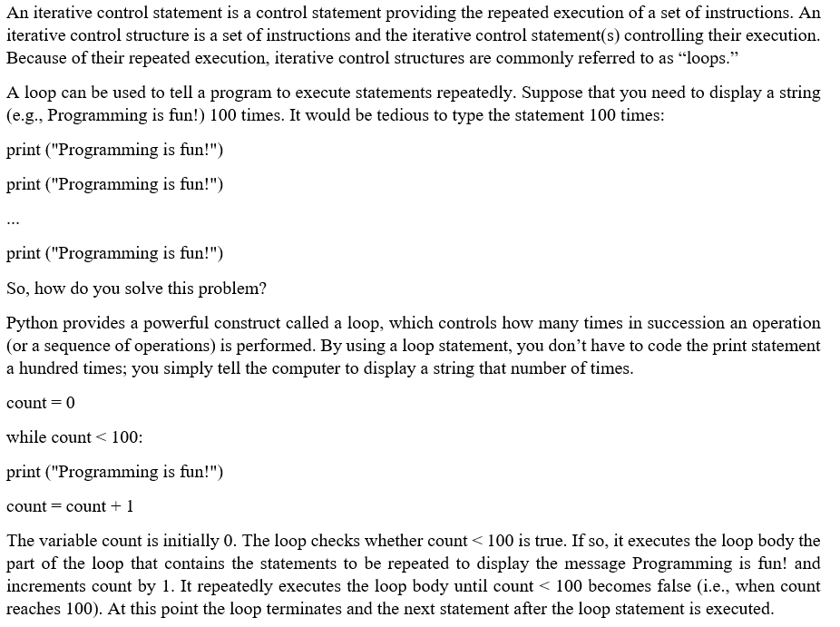
ITERATIVE CONTROL

Slide 3
DIFFERENT TYPES OF LOOPS

Slide 4
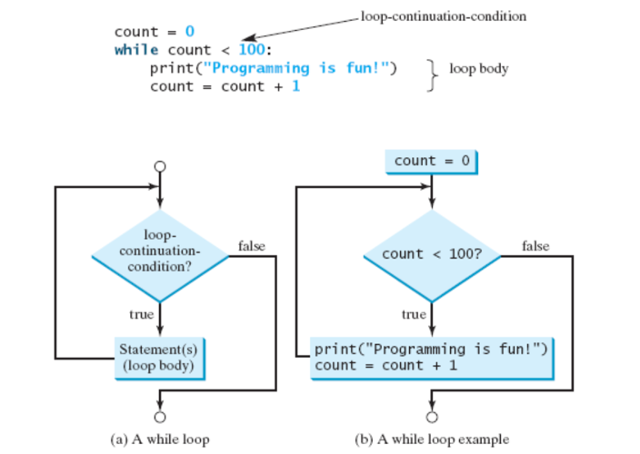
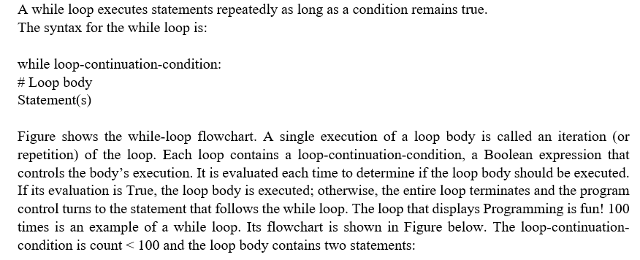
While Loop

Slide 5
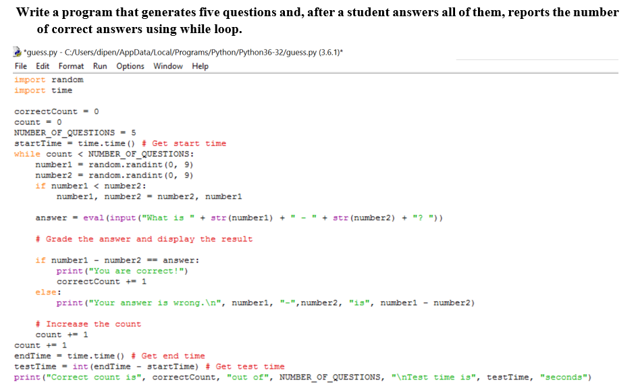
PROGRAM

Slide 6
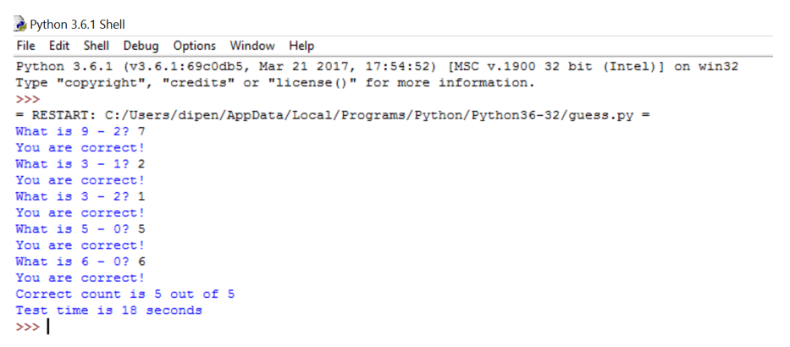
OUTPUT

Slide 7
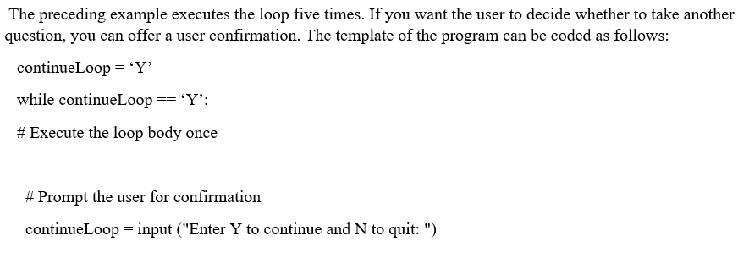
Controlling a loop with User Confirmation

Slide 8



Slide 9
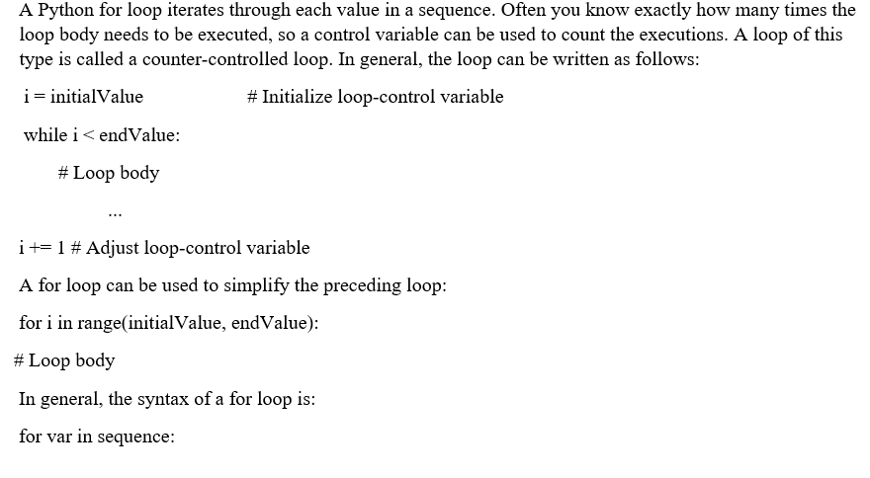
The for Loop

Slide 10

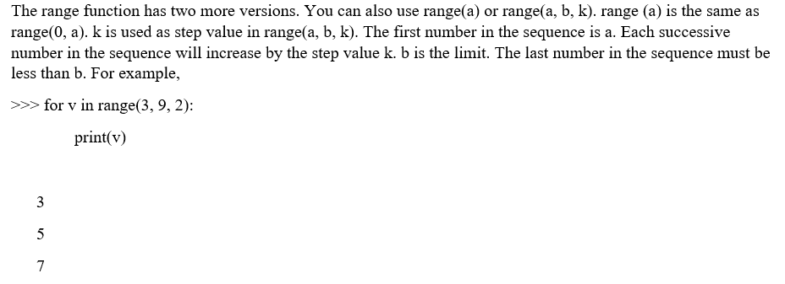
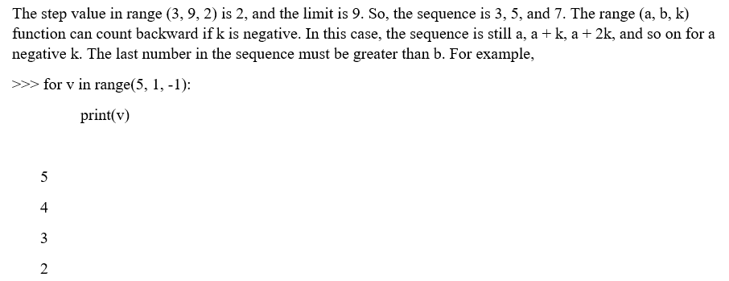
For loop

Slide 11

NESTED LOOPS

Slide 12
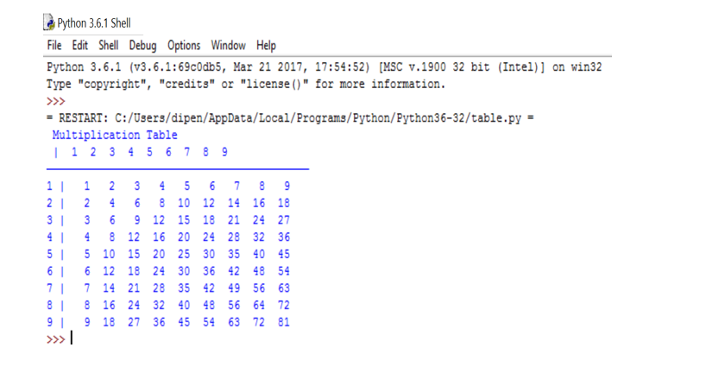
OUTPUT OF THE PROGRAM

Slide 13
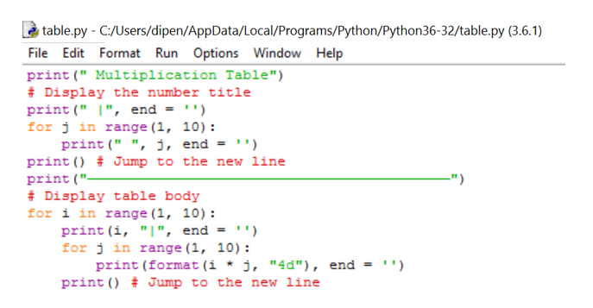
MULTIPICATION TABLE

Slide 14

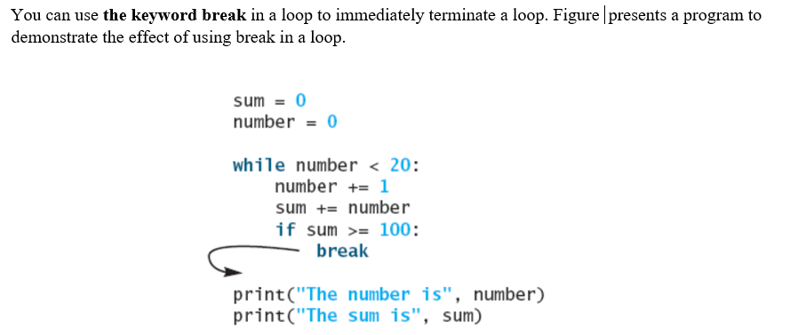
BREAK KEYWORD

Slide 15
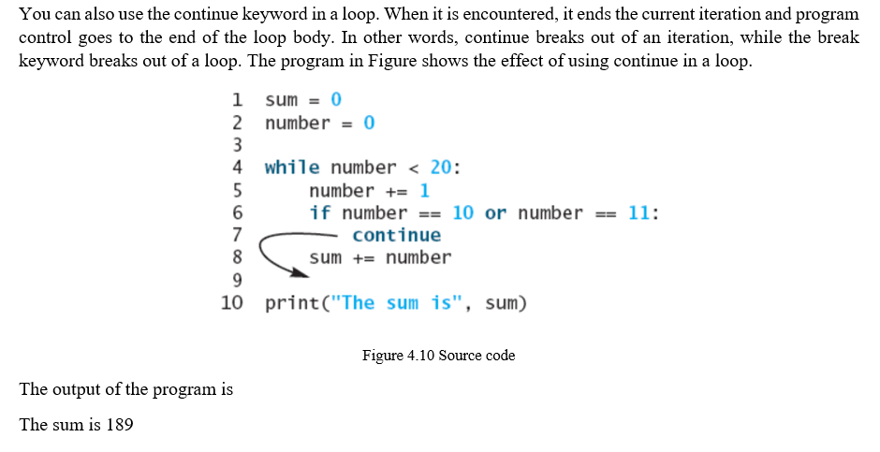

CONTINUE KEYWORD

